Slide 1
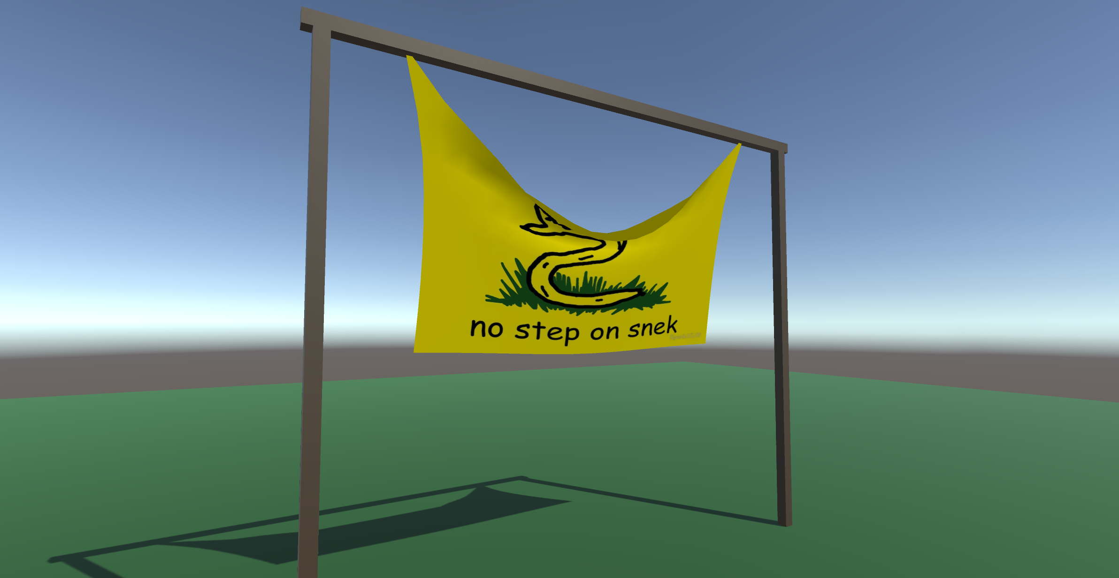
Cloth Simulation
Douwe van Gijn
Christian Knaapen

Slide 2
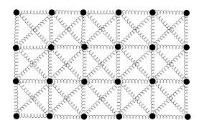
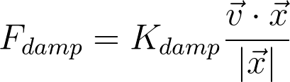
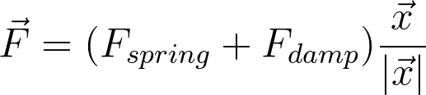
Mass-spring system
Grid of vertices connected with springs

Slide 3
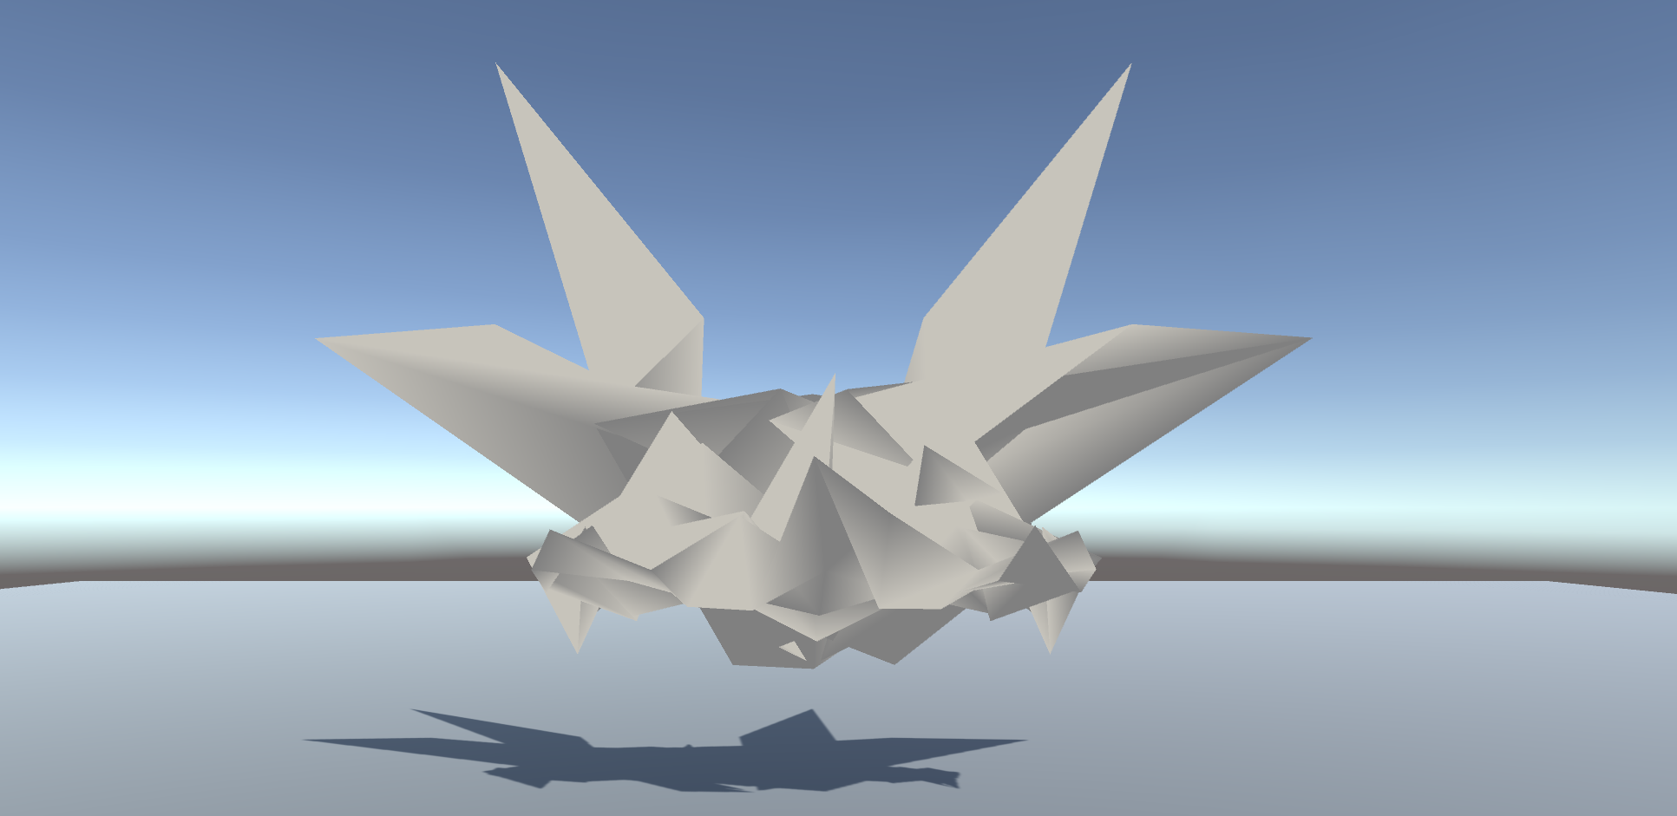
Explicit Euler integration
Everything exploded
Glitchy mess
Infinite energy

Slide 4
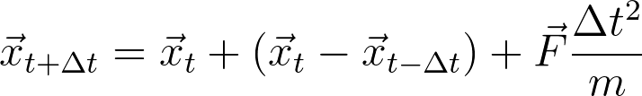
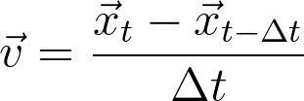
Verlet ​[vɛʁˈlɛ] integration
Incredibly stable!
4th order accurate → as good as Runge-Kutta
As cheap as Euler
Does not have velocity terms

Slide 5
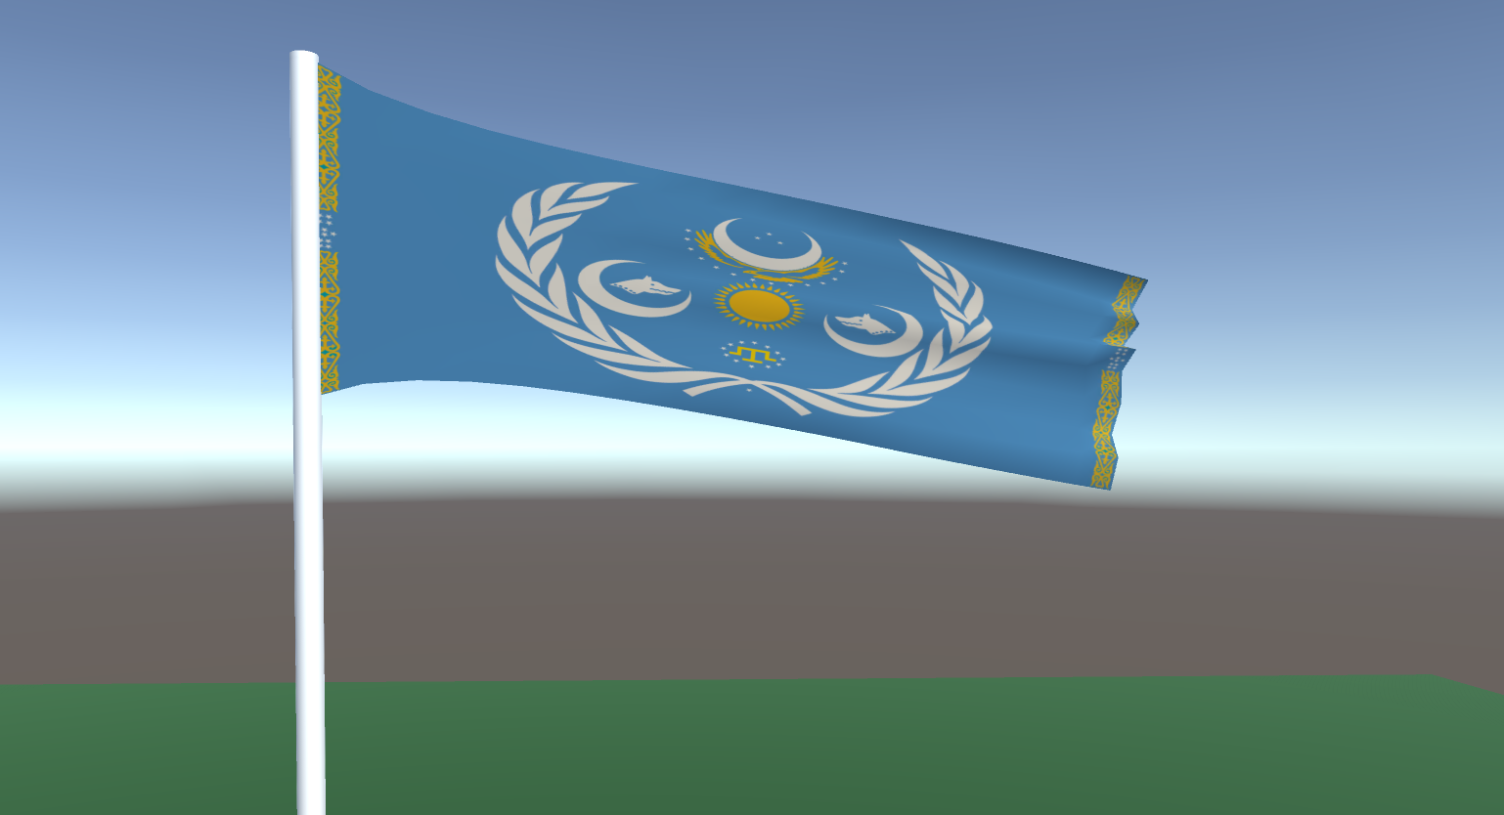
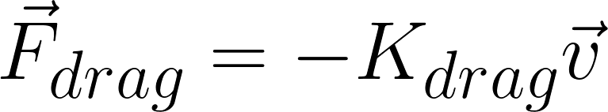
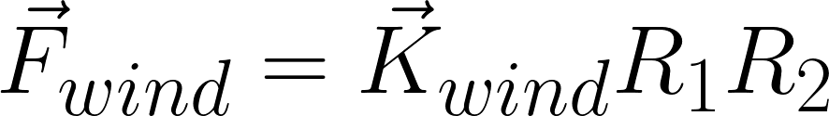
Drag and Wind
Highly scientific
Totally not a hack
R₁: random number in range [0.2, 1], renewed every 30 frames
R₂: random number in range [0.8, 1.2], renewed every frame

Slide 6
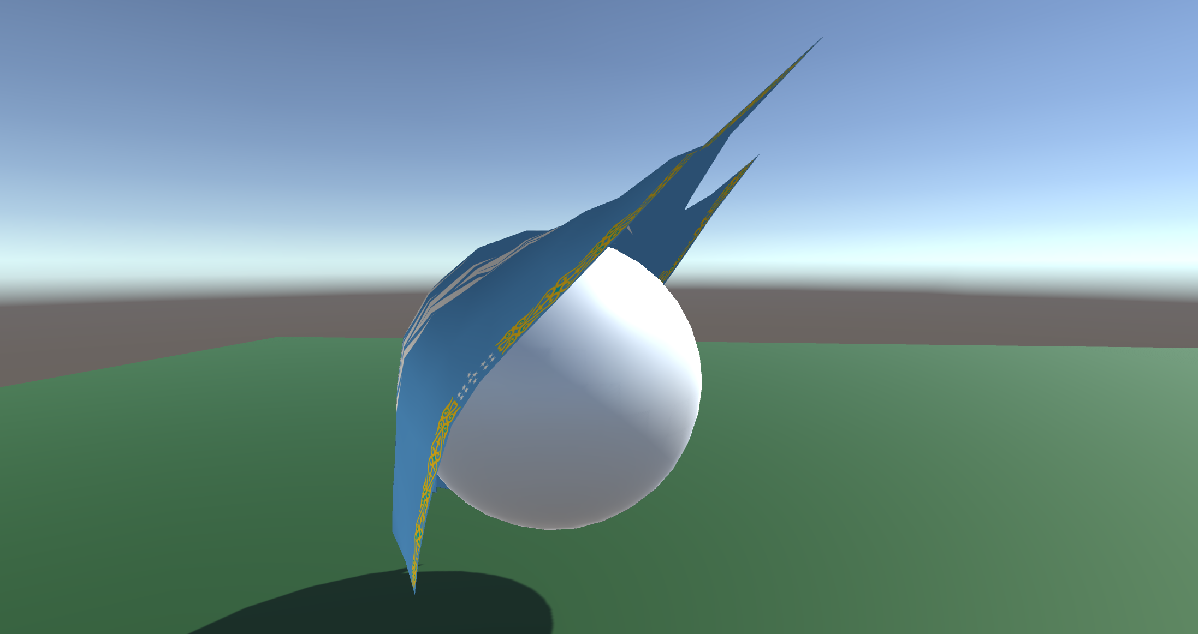
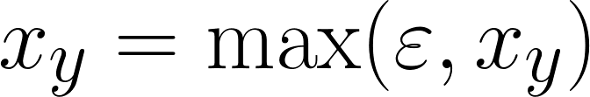
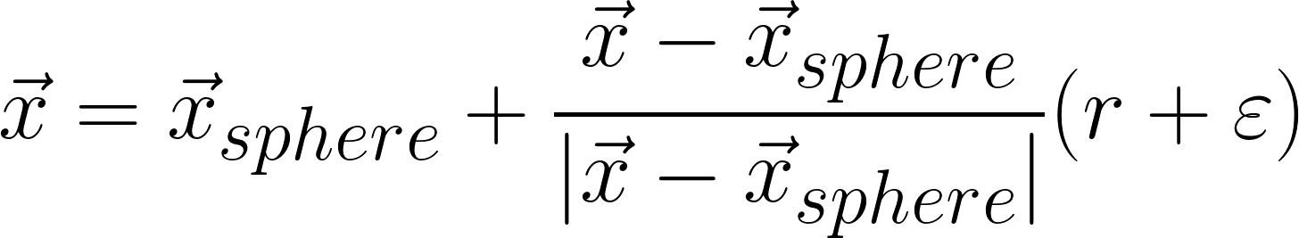
Collision
Ground
Sphere
If inside sphere
epsilon: small number to prevent z-fighting and visual glitches

Slide 7
Polish
Unity3D
Custom mesh
Tweakable parameters
Textures
‘Professional’ 3D modeling
Decades of tweaking

